Slide 1
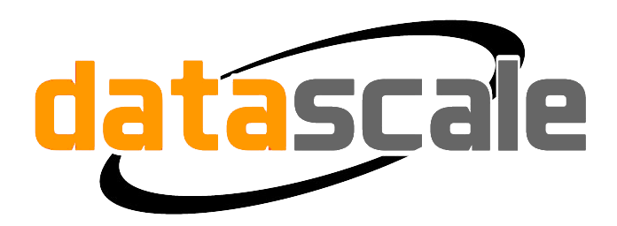
From Experimentation to Large Scale Cassandra Usage

Slide 2


Christos Kalantzis
Executive Chairman - DataScale.io
@chriskalan
linkedin.com/in/christoskalantzis

Slide 3
“He who would learn to fly one day must first learn to stand and walk and run and climb and dance; one cannot fly into flying.” Friedrich Nietzsche
Notes:
One of my favorite quotes
He who would learn to fly one day must first learn to stand and walk and run and climb and dance; one cannot fly into flying.
For anyone starting out with a new technology such as C*, it is very fitting.

Slide 4

Notes:
Not going to cover technical aspects of C* - plenty of talks about that in the next couple of days
The organizational,
purchasing,
tooling
and human resource decisions
your company will have to make as you journey from experimentation to Large scale deployment of Apache Cassandra.

Slide 5

Notes:
You weighed your needs You evaluated CAP theorem you compared the offerings on the market you concluded that C* was the best solution for you Congratulations and welcome to the C* community What now?

Slide 6

Notes:
The biggest mistake I’ve seen over the years, is trying to do too much too soon.
Don’t try to re-architect and migrate the most critical parts of your app to C* as your first integration. Choose a service, or part of your app that doesn’t greatly affect your business and start there.
Schema design differs from what you were used to in the RDBMS world. However, with CQL less than before. The main difference is that you cannot join between tables, so you need to denormalize and write the same data to multiple tables. This puts more responsibility on the application layer.
Your team will have to evaluate, adapt, learn new things and understand scale. You don’t want to find yourself deep into a major re-architecture and realize your design is faulty.

Slide 7
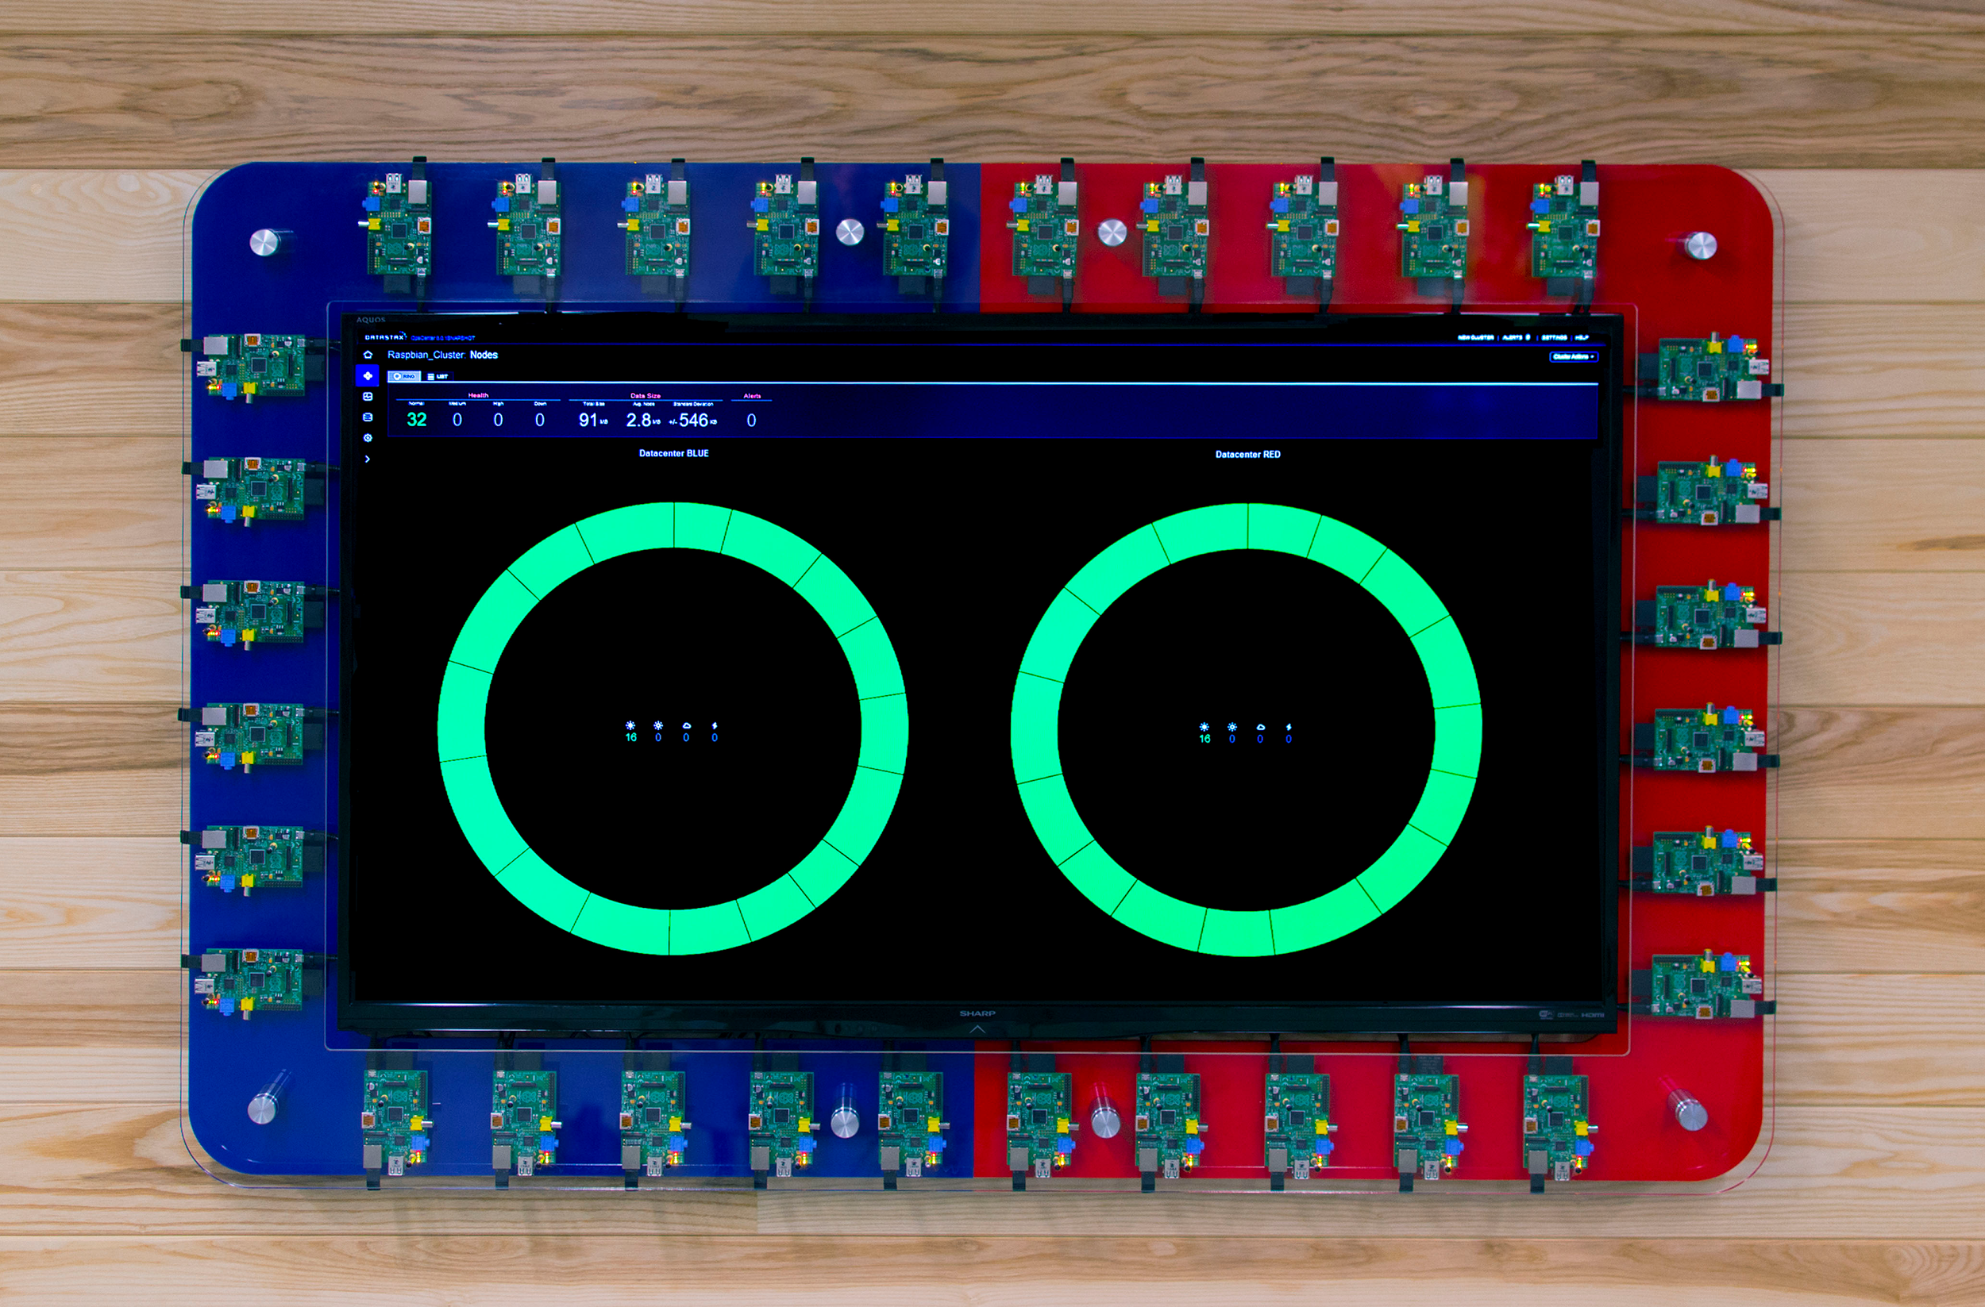
Should I run it?
Notes:
I believe you should run your first C* cluster at least during the dev and testing phase, and even in production.
C* is much different from your single Master scale-up RDBMS. Just like at the application layer, Cassandra differs at the operaional layer. Your Operations teams needs to evaluate what it takes to deploy, maintain and troubleshoot a distributed Database, like C*.
Is the proper monitoring in place? …..can they remediate?
Does the staff correlate and troubleshoot issues….. distributed JVM based databases and all the intricacies that come with it?
You don’t know what you don’t know until you do it.
Since you’ve chosen a non-critical piece of your application, if you muck it up, it shouldn’t be a big deal.

Slide 8

Notes:
So you’ve established that you can refactor an app, or right a new one, using C*’s schema. It is taking some load in Production and you’ve probably had an intentional or unintentional node go down. You’ve seen how C* gracefully handles such a failure and the effort required to make your cluster whole again.
With your confidence much higher, you are ready to tackle more important pieces of your app
Complex schema requires more experience. New cpncepts like partition and clustering keys are confusing.
more throughput and lower latencies. As you start performance testing the new implementation, you will be disappointed. Why? C* is a very flexible piece of database software that can be configured for multiple different workloads. The defaults are good enough to get you started and support a small use case. If you want to do anything of interesting load, you will have to understand those configurations.
What those configurations do and how they interact with each other, including the JVM and its settings, will greatly affect the performance of C* and your app.

Slide 9

Get Help
Notes:
You can probably start a big cycle of performance tuning that would entail playing with C* configurations and JVM settings to get the performance you require for your app. This will require someone who intimately understands those C* configurations and someone who understands the JVM, its settings and how those settings interact with C* and the particular workload you are sending to C*.
Even Netflix asks for help once in awhile.
These are very specialized skills, which you should feel very proud of if you have in-house. Unfortunately most companies do not have those skills in-house nor do I think you should at your particular scale.
As the C* feature set grows and becomes more complex, understanding best practices becomes very important.
There are experts out there that can help you. Third party experts will become very important to your overall strategy and success of your application

Slide 10
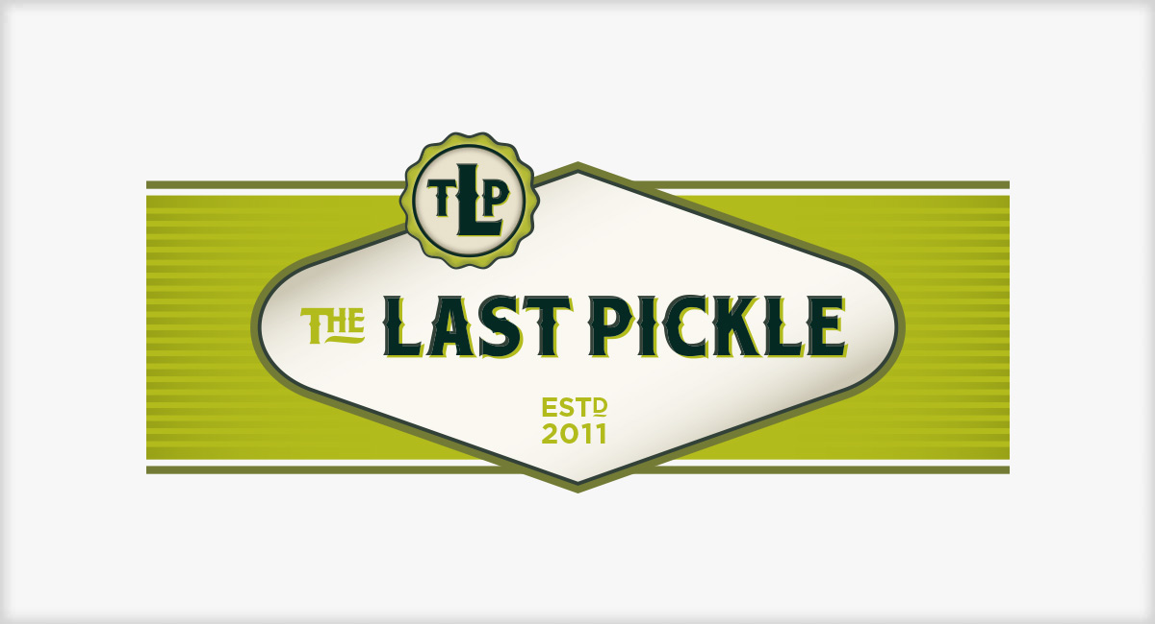

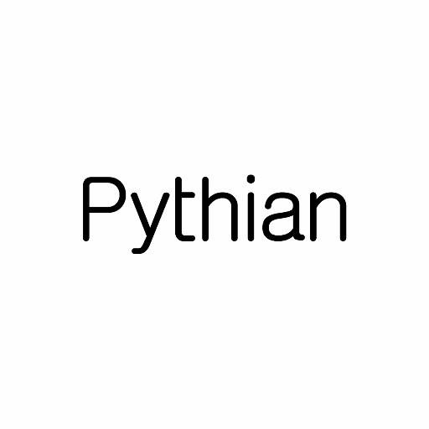
Notes:
The Last Pickle - People I trust
Datastax - The makers of Datastax Enterprise, the Enterprise version of Apache Cassandra
Or Pythian…….just to name a few

Slide 11
Should I run it?
Notes:
You ran a cluster already. But that wasn’t critical.
Cassandra highly available but not magic or self healing.

Slide 12
What you need to run Cassandra
Telemetry System
Auto Determination
Auto Remediation
Lots of Coffee
Notes:
Telemetry system
OpsCenter - Datastax Licence
Datadog
Quickly determine and correlate metrics to determine what an issue is
C*?
Your DC ?Cloud Vendor?
Your app?
Have fixit scripts ready that will fix your issues
Lots of coffee available
This is not unattainable. The question is are you within your company’s C* usage lifecycle that it makes sense to invest in building all of this out? Can your product wait that long?

Slide 13
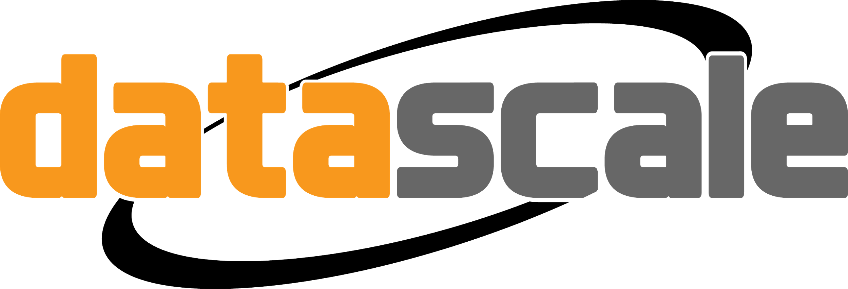

Managed Cassandra
Notes:
I believe at this stage you should probably seek out a managed service.
Datascale to the rescue! Instaclustr?

Slide 14

You’ve learned to walk
Notes:
Recap where you are.
You’ve been running critical systems on C* for a while.
You might be thinking about bringing all in-house.
Should you do this?
This depends greatly on your company’s culture….and how big you are.

Slide 15
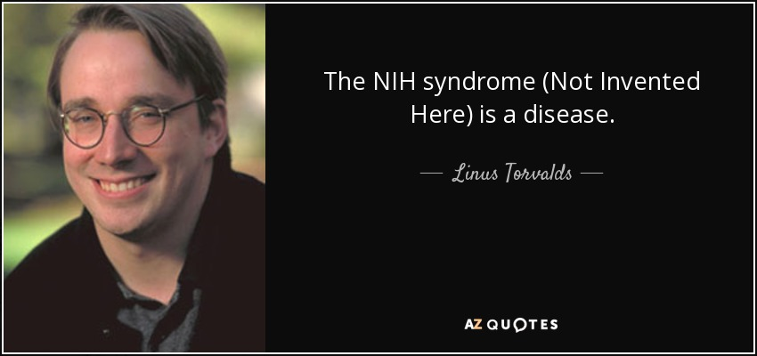
Notes:
I believe you should concentrate on your product and what makes you unique and let others who’s primary focus is that technology, manage the plumbing underneath. This is how you grow your product quickly.

Slide 16

Notes:
I’ve seen many articles talking about managed services not being cost effective.
It isn’t purely a $ issue. The value of not having to build all that supporting infrastructure and manage that staff, greatly outweighs the cost of doing so.
There is a big opportunity cost being incurred when you decide to reroute resources from product to infrastructure.
It usually is more efficient to have someone else run all of that infrastructure.
This is what NEtflix did, when they decided to go to the cloud.

Slide 17
Recap

Slide 18

Q&A - Thank you
Christos Kalantzis
Executive Chairman - DataScale.io
@chriskalan
linkedin.com/in/christoskalantzis

